Slide 1
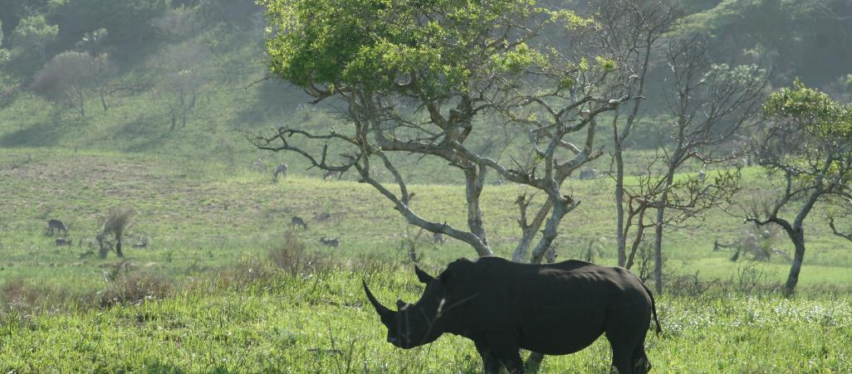


Biodiversity and Protected Areas Management (BIOPAMA) Programme
Small Technical Grants
February 2022

Slide 2

Outline
Objectives of the call
Financial allocation
Eligibility criteria
Proposals submission
Proposals evaluation
Timeline
An initiative of the ACP Group of States financed by the European Union's 11th EDF.

Slide 3
Call objective
Specific Objective:
To support the development of national and/or regional policies and actions based on scientific evidence and data. This includes for example (but is not limited to) the development of a national approach to sustainable financing, to equitable governance and management effectiveness, or to the identification of other effective area-based conservation measures (OECMs)
Maximum duration: 12 months
An initiative of the ACP Group of States financed by the European Union's 11th EDF.
Notes:
key management and governance issues identified by a quantitative management and governance assessment tool (such as IMET, METT, RAPPAM, Green List, EoH, or equivalent for PAME tools, or SAGE, SAPA, GAPA for PAGE tools) are eligible.
Projects must end on, or before 30 September 2024. No extension of the grant agreements will be possible beyond 30 September 2024.

Slide 4
Financial allocation
Total of total 398,000 EUR is available
Grant amount: 20,000 ≤ 50,000 EUR
Co-financing is not required
The proposed project activities should be consistent with the amount requested
Set aside between 5 to 10% of total project costs to monitoring, evaluation and communication activities
An initiative of the ACP Group of States financed by the European Union's 11th EDF.
Notes:
1,5 million EUR is reserved for the following countries in Eastern and Southern Africa: Ethiopia, Kenya, Rwanda, Tanzania, Uganda, Madagascar, Mozambique, and Zambia.
The required communication activities include:
Two articles a year produced and published on the organisation’s communication channels;
A brief video testimonial from the beneficiaries about the project;
A PANORAMA solution;
A success story about the project implementation and lessons learnt;

Slide 5
Eligibility criteria
Eligible countries
Angola
Botswana
Comoros
Djibouti
Eritrea
eSwatini
Ethiopia
Kenya
Lesotho
Madagascar
Malawi
Mauritius
Mozambique
Namibia
Rwanda
Seychelles
Somalia
South Africa*
South Sudan*
Sudan
Tanzania
Uganda
Zambia
Zimbabwe
South Africa and South Sudan are not eligible but Transboundary activities involving these two countries are eligible.
Organisations from OECD Member Countries are not eligible to apply for projects in countries in red – not part of LDC or a Highly Indebted Poor Countries (HIPC).
An initiative of the ACP Group of States financed by the European Union's 11th EDF.

Slide 6
Eligibility criteria
Eligible actors
a network or cluster of protected areas at the national or regional level. Single protected/conserved area/s are not eligible.
a national civil society organisation, national NGO, non-profit organisation, national authority, agency established in the targeted eligible country(ies)
All applications must be supported by the relevant national authority
An initiative of the ACP Group of States financed by the European Union's 11th EDF.
Notes:
be a registered legal entity and
be directly responsible for the preparation and management of the grant, not acting as an intermediary and
be non-profit-making and
be:
a targeting network or cluster of protected areas at the national or regional level. Single protected/conserved area/s are not eligible.
a national civil society organisation, national NGO, non-profit organisation, national authority, agency established in the targeted eligible country(ies)
not be a beneficiary of another active grant funded by a donor, including the European Union, for the same activities, or
an EU member state organisation, EU OCT organisation, OECD member state organisation, or regional or international organisation, provided the following conditions are fulfilled:

Slide 7
Eligibility criteria
Eligible activities
Activities must:
Focus on development of national and/or regional policies, strategies and actions, including validation of same
Address clearly formulated priorities (preferably identified through the use of a quantitative diagnostic tool)
Be consistent with the BIOPAMA action component objectives (see section 1.2)
Enable sharing of project data and information with the relevant BIOPAMA regional observatory, as relevant
An initiative of the ACP Group of States financed by the European Union's 11th EDF.
Notes:
be a registered legal entity and
be directly responsible for the preparation and management of the grant, not acting as an intermediary and
be non-profit-making and
be:
a targeting network or cluster of protected areas at the national or regional level. Single protected/conserved area/s are not eligible.
a national civil society organisation, national NGO, non-profit organisation, national authority, agency established in the targeted eligible country(ies)
not be a beneficiary of another active grant funded by a donor, including the European Union, for the same activities, or
an EU member state organisation, EU OCT organisation, OECD member state organisation, or regional or international organisation, provided the following conditions are fulfilled:

Slide 8
Ineligible activities
Financial support to third parties through sub-grants.
Purchase of land or involuntary resettlement of people.
Activities on indigenous peoples’ lands and territories without their free, prior and informed consent, or activities on land contested by local communities or indigenous people.
Removal or alteration of any physical cultural property (e.g. sites with archeological, paleontological, historical, religious or unique natural values).
Activities that may affect vulnerable groups within local communities or indigenous people.
Procurement, handling, storage and use of unlawful pesticides.
Activities duplicating work previously funded by BIOPAMA.
An initiative of the ACP Group of States financed by the European Union's 11th EDF.

Slide 9
How to apply
Applications can be submitted only through the BIOPAMA Action Component online portal on https://action.biopama.org/
1) Applicants need to create an account.
2) Fill in the application template offline and then upload it on the portal.
3) Upload all supporting documents
3) Applicants can save a draft and submit once the application is completed.
Once submitted, applications cannot be modified.
Applicants who already have a user profile can use it to apply.
The function allowing users to submit the application will be enabled on 14 March 2022.
Applicants may submit proposals in English or French.
An initiative of the ACP Group of States financed by the European Union's 11th EDF.

Slide 10
A one-step application process
Applicants are requested to submit the full proposal as well as all supporting documents all at once and before the call closing deadline on 10 April 2022
Technical proposal
Full assessment report (optional, only provide if relevant)
Applicant and co-applicant signed declarations
Letter of support from relevant national authorities
Due diligence questionnaire, and necessary supporting documents to the due diligence
Simplified ESMS questionnaire
Full budget
Logical Framework
An initiative of the ACP Group of States financed by the European Union's 11th EDF.
Notes:
Failure to provide any of the above-mentioned documents will result in the invalidation and immediate rejection of the proposal.

Slide 11
Evaluation of applications
The review and contracting process is expected to take a maximum of 3 months following the deadline of the Call for Proposals.
Administrative check: deadline, assessment report, eligibility, supporting documents, etc.
Proposals that pass the administrative check will be evaluated on the relevance and design of the proposed activities (Evaluation sheet)
An initiative of the ACP Group of States financed by the European Union's 11th EDF.
Notes:
All submitted applications that are incomplete upon receipt will not be eligible for funding. Once the deadline for the call expires, all incomplete applications within the system that have been saved but not submitted will be automatically rejected.

Slide 12
Indicative timeline
Activities | Deadline | Time (GMT+1)
Portal opens for submission | 21 March 2022
Deadline for requesting any clarifications from the BIOPAMA teams | 5 April 2022 | 23:59
Deadline for proposal submission | 10 April 202 | 23:59
Internal and expert proposal review | 06 June 2022
Notification of applicants of successful and unsuccessful proposals | From 13 June 2022
Signature of grant agreements | Between 15 June and 31 July 2022
An initiative of the ACP Group of States financed by the European Union's 11th EDF.
Notes:
All submitted applications that are incomplete upon receipt will not be eligible for funding. Once the deadline for the call expires, all incomplete applications within the system that have been saved but not submitted will be automatically rejected.

Slide 13
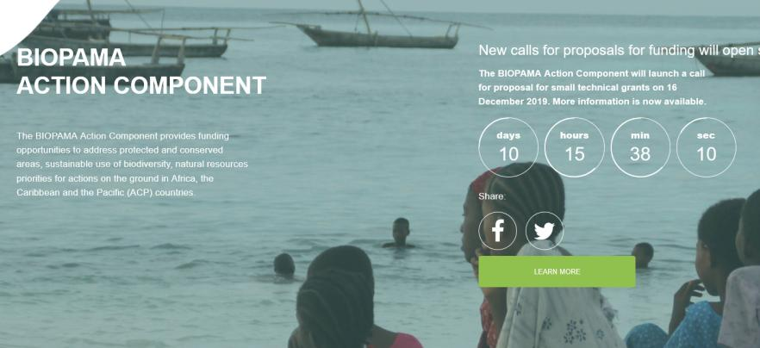
Small Technical Grants
For more details: https://action.biopama.org/
An initiative of the ACP Group of States financed by the European Union's 11th EDF.

Slide 14

Thank you!
An initiative of the ACP Group of States financed by the European Union's 11th EDF.

