Slide 1

BIOPAMA Action Component – Medium Grants 2019
BUDGET advice for applicants
Version 1_July2019
An initiative of the ACP Group of States financed
by the European Union’s 11th EDF

Slide 2
Planning tool : activities and objectives are budgeted
Control tool : expenditures are controlled
Financial compliance tool : main heading = overall spending limits
Budget mirrors the financial report : expenditures incurred will be compared with budgeted costs
Budget is a KEY aspect of your project
- evaluation of your proposal
(alignment with objectives, activities, timeline)
- reference document
(project implementation and financial reporting)
Your budget should be clear, transparent, comprehensive and realistic

Slide 3

Grant amount
Maximum amount of contribution by BIOPAMA = 400,000€ AND UP TO 95% of the total budget.
  Example 1:
Total grant budget =500,000€.
BIOPAMA contribution maximum =400,000€
BIOPAMA contribution % =400,000€/500,000 = 80%
  Example 2:
Total grant budget =421,052€.
BIOPAMA contribution maximum =400,000€
BIOPAMA contribution =400,000€/421,052 = 95%

Slide 4

Grant amount
If unconfirmed sources of co-funding are included and then do not materialise, you will still be required to cover the proportion of the final eligible costs indicated in the budget as being co-funded.
We strongly advise to include only confirmed sources of co-funding in the project budget.
The amount requested
  Must be consistent with your proposed project activities and workplan.
  Should be linked with the financial capacity of your organisation
  It is not necessary to ask for the maximum available amount of BIOPAMA contribution.
Be realistic in terms of what can be realised and expended during the lifetime of the project!

Slide 5
Add rows! Costs should not be grouped together. Each cost item should be presented on a separate row.
→ Each cost = distinct line
Use sequential numbering for each line in the budget
For each cost indicate which partner is responsible for/will incur the cost
1.1.2 Administrative/ support staff
1.1.2.1. Partner A.
1.1.2.2. Partner B.

Slide 6
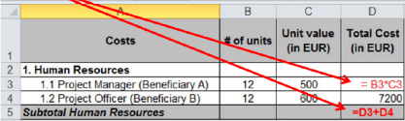
The total budget stated in the project proposal MUST be equal to the total budget shown in the budget worksheet.
The total of the costs in the budget worksheet on the tab ‘‘Budget’’ MUST be equal to the total amount of income in the tab ‘‘Expected Sources of Funding’’.
You should use formulae in the budget worksheet. Please do not use hardcoding.

Slide 7
Co-financing

Slide 8

The budget must include ALL the costs of the project funded from ALL sources.
It is not sufficient to only include the costs equal to the BIOPAMA contribution requested!
ALL costs of the project, independent of the funding source, must comply with BIOPAMA eligibility rules.
ALL costs of the project are subject to verification, be it spot checks or final audit.

Slide 9
Understanding the mechanism of co-financing is crucial for the financial implementation of BIOPAMA grants.
WHY?
The final amount of funds to receive from BIOPAMA is determined by taking into account all contributions received from various sources.
HOW?
1. At the budget stage – estimated amounts
2. At the reporting stage – final amounts
At the budget stage – estimated amounts:
BIOPAMA contribution has two ceilings:
1. a fixed % of the total project budget
and
2. a maximum amount of the contribution.
Example budget
total project budget = 421,051€
co-financing by donor A = 5% or 21,051€
BIOPAMA contribution is UP TO 400,000€ and will cover 95% of eligible costs.

Slide 10

At the reporting stage – final amounts
Example 1: underspent at the final report (i.e. at the end of the project)
Total reported eligible costs = 400,000€
BIOPAMA contribution
400,000€ x 95% = 380,000€
Example 2: overspent at the final report (i.e. at the end of the project)
Total reported eligible costs = 450,000€
BIOPAMA contribution = 400,000€ (= maximum contribution)
Co-financing is a fixed contribution (in %) to the total eligible costs of the project.
Co-financing IS NOT A CONTRIBUTION OF SPECIFIC COST ITEM IN THE BUDGET!

Slide 11
In-kind contributions

Slide 12

Do not represent actual expenditure and are not eligible costs.
They are constituted by non-financial resources (such as equipment, goods or service) provided to the beneficiary free of charge by a third party
They do not involve any expenditure by the beneficiary and do not generate costs in its accounts
Example : a venue is provided to the beneficiary by a third party free of charge
This does not generate a cost in the accounts of the beneficiary
Not in-kind contribution
Example :
the beneficiary uses its own car/boat
This generates fuel costs. It is a real eligible expenditure
salary costs of beneficiary’s personnel are not in-kind contribution

Slide 13
Direct and indirect costs

Slide 14

Direct costs
Project-specific costs directly linked to your project implementation
They are identifiable, verifiable and are supported by documentary evidence
Indirect costs
Are not identified as specific costs directly linked to the project
They are typically structural or support costs of an administrative, technical and logistical nature
They are cross-cutting for the operation of the beneficiary’s various activities/projects and cannot be attributed in full to one single project

Slide 15
Costs of infrastructure and general operation, such as :
Administrative and financial management
Human resourses
Training
IT service
Legal advice
Documentation
Maintenance of building
Water, gaz, electricity
Insurance
Office supplies
Communications
Accounting fees
Depreciation
Telephone bills and other utilities costs, etc.

Slide 16

The flat rate funding of indirect costs simplifies project administration
The use of flat rate funding is encouraged, since no supporting document is required
The MAXIMUM of flat rate funding is 7 % over ‘‘subtotal of direct eligible costs of the project’’
It is not possible to include indirect costs in your budget as direct costs + benefit from the 7 % flat rate.
This DOUBLE-FUNDING and is not allowed !

Slide 17
Budget categories
Human resources
Per diems
Travel
Office costs
Other costs and services

Slide 18
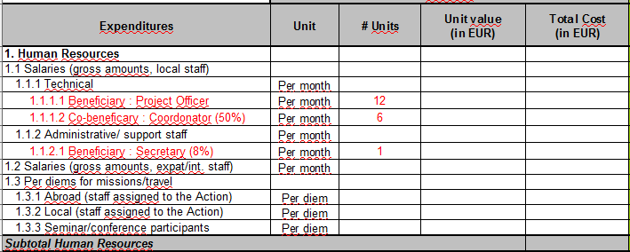
Salaries : eligible costs for both benficiary/co-beneficiary
Must include all costs related to the staff member : gross salary, taxes and levy
social security charges + other potential costs : visa cost, renting allowance...

Slide 19
Example: Coordinator 25% over 3 years= 12 months x 3 x 25% = 9 months.
If staff is not working full-time on the project, the percentage must be reflected
in the number of units, NOT in the unit value.

Slide 20

The rate is established according to the organisation internal per-diem/travel policy .
Actually incurred costs can be reported in the absence of per diems policy. This is much more time-consuming!
The per diem rates cannot exceed Per diem rates applicable to EU-funded external aid contracts - 17/03/2017.
https://ec.europa.eu/europeaid/node/116255
Costs related to : accommodation, local travel, subsistence, various ancillary
costs (eg : phone credit)

Slide 21
Travel : eligible costs for and service provider.
Costs of using own vehicles must be justified by a regularly updated logbook.
1. 1. BIOPAMA II - Budget for Medium Grant | Unit ¹³ | # of units | Unit value (in EUR) | Total Cost (in EUR)⁵
2. Travel
2.1. International travel (flights, trains). | per flight | 10 | 500 | 5000
1. 1. BIOPAMA II - Budget for Medium Grant¹ | Unit ¹³ | # of units | Unit value (in EUR) | Total Cost (in EUR)⁵
2.3.Local transportation - use of own vehicles. | Per km | 5000 | 0.3 | 1,500.00

Slide 22
Office rent should be equal to 0€, if it is included in the indirect costs.
If office rent is budgeted in the direct costs, provide the cost share rationale in the justification sheet.
1. BIOPAMA II - Budget for Medium Grant | Unit ¹³ | # of units | Unit value (in EUR) | Total Cost (in EUR)⁵
4. Office costs
4.2. Office rent. | per month | 24 | 500 | 12000

Slide 23
This heading is exclusively used for the costs where works/services are sub-contracted to third parties.
1. 1. BIOPAMA II - Budget for Medium Grant¹ | Unit ¹³ | # of units | Unit value (in EUR) | Total Cost (in EUR)⁵
5. Other costs, services¹⁵
5.1 Publications¹⁰
5.1.1. Partner A. | by brochure | 50 | 20 | 1,000.00
5.1.2. Partner B | by flyer | 100 | 40 | 4,000.00
5.2 Studies, research¹⁰
5.3 Expenditure verification¹¹
5.4 Evaluation costs
5.5 Translation, interpreters
5.6 Financial services (bank guarantee costs etc.)
5.7 Costs of conferences/seminars¹²
5.7.1. Partner A. Capacity-building event. | by event | 2 | 10000 | 20,000.00
5.7.2. Partner B. Partners' meetings | by meeting | 3 | 5000 | 15,000.00
5.8. Visibility actions¹³
Subtotal Other costs, services

Slide 24
For each cost indicate which partner is responsible for/will incur the cost.
Specify the type of cost or service. Overall general amounts are not allowed.
Communication and visibility activities should be planned and budgeted at each stage of the project implementation – they must be described in your proposal.
Seminars/events/conferences must be supported by a full breakdown of costs in the justification sheet.

Slide 25
5. Other costs and services - PROCUREMENT
For purchase of goods and services the procurement method that will be used should be described in the tab ‘‘justification’’.
Any purchase of goods or services must comply with the BIOPAMA Procurement Policies.
Lead applicants/Co-applicants cannot be service providers!

Slide 26
Budget units and justification

Slide 27
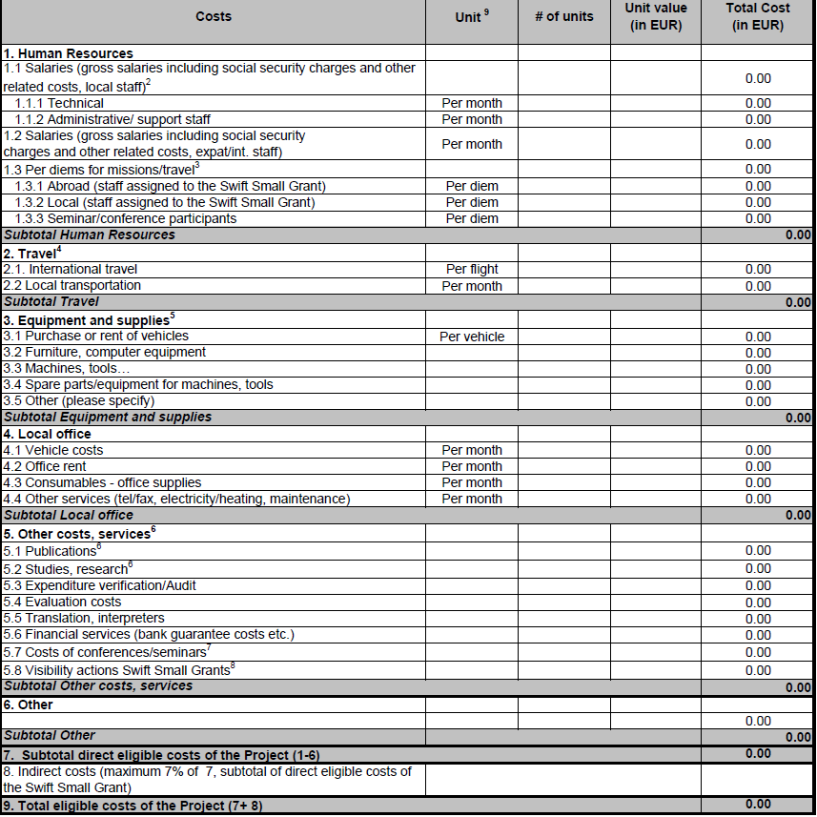


Choose an appropriate unit for costs in the budget. It will make your reporting much easier! (Units in the template are a guide; they can be changed).
IT IS RECOMMENDED TO USE HOURS FOR THE HUMAN RESOURCES CATEGORY
Vehicle rental costs: could be “per day”
Unit for studies/work that will be subcontracted could be “per contract”
The justification sheet should then be used to explain what the cost comprises:
e.g. one expert for 10 working days (€300 per day) + return flight from X to Y + subsistence costs for 12 days)

Slide 28
1. 1. BIOPAMA II - Budget for Medium Grant | All Years
Costs | Clarification of the budget items | Justification of the estimated costs
1. Human Resources⁶ | Provide a narrative clarification of each budget item demonstrating the necessity of the costs and how they relate to the action (e.g. through references to the activities and/or results in the Project Proposal). See instructions. | Provide a justification of the calculation of the estimated costs. Note that the estimation should be based on real costs or on simplified cost options if allowed. See instructions.
1.1 Salaries (gross salaries including social security charges and other related costs, local staff) | The use of simplified costs option "UNIT COSTS" is allowed for Human Resources.
1.1.1 Technical
1.1.1.1. Partner A. Project coordinator 80% | Project coordinator in charge of <description of the tasks> | 30 months at 80% = 24 months at <amount>/month
2. Travel | The use of simplified costs option "UNIT COSTS" is allowed for: 2.3. Use of own vehicles and 2.4. per diems for missions/travel.
2.1. International travel (flights, trains). | Travel to/from pilot sites to deliver trainings to local project beneficiaries | Per year : 10 flights x 400€/flight = 4,000€ Total 3 years x 4,000€ =12,000€
2. Travel | The use of simplified costs option "UNIT COSTS" is allowed for: 2.3. Use of own vehicles and 2.4. per diems for missions/travel.
2.1. International travel (flights, trains). | Travel to/from pilot sites to deliver trainings to local project beneficiaries | Per year : 10 flights x 400€/flight = 4,000€ Total 3 years x 4,000€ =12,000€
Please provide clear and well supported justification of each cost. The financial coherence of the budget is an important selection criterion.

Slide 29
1. 1. BIOPAMA II - Budget for Medium Grant | All Years
Costs | Clarification of the budget items | Justification of the estimated costs
1. Human Resources⁶ | Provide a narrative clarification of each budget item demonstrating the necessity of the costs and how they relate to the action (e.g. through references to the activities and/or results in the Project Proposal). See instructions. | Provide a justification of the calculation of the estimated costs. Note that the estimation should be based on real costs or on simplified cost options if allowed. See instructions.
1.1 Salaries (gross salaries including social security charges and other related costs, local staff) | The use of simplified costs option "UNIT COSTS" is allowed for Human Resources.
1.1.1 Technical
1.1.1.1. Partner A. Project coordinator 80% | Project coordinator in charge of <description of the tasks> | 30 months at 80% = 24 months at <amount>/month
2. Travel | The use of simplified costs option "UNIT COSTS" is allowed for: 2.3. Use of own vehicles and 2.4. per diems for missions/travel.
2.1. International travel (flights, trains). | Travel to/from pilot sites to deliver trainings to local project beneficiaries | Per year : 10 flights x 400€/flight = 4,000€ Total 3 years x 4,000€ =12,000€
2. Travel | The use of simplified costs option "UNIT COSTS" is allowed for: 2.3. Use of own vehicles and 2.4. per diems for missions/travel.
2.1. International travel (flights, trains). | Travel to/from pilot sites to deliver trainings to local project beneficiaries | Per year : 10 flights x 400€/flight = 4,000€ Total 3 years x 4,000€ =12,000€
Please provide clear and well supported justification of each cost. The financial coherence of the budget is an important selection criterion.

Slide 30
Simplified cost option (SCO)

Slide 31
The use of SCO reduces SIGNIFICANTLY the volume of administrative workload.
A unit cost is allowed for budgeting the following cost categories:
  1. Human resources
  2. Local transportation (use of own vehicles)
  3. Per diems for missions/travel
  4. Office costs
  At the budget stage:
  A unit cost is fixed at the budget approval stage and cannot be changed.
  Unit costs are assessed and approved by the Secretariat based on the submitted documentation at the budget stage.

Slide 32
The use of SCO reduces SIGNIFICANTLY the volume of administrative workload.
  At the reporting stage*:
  Auditors will not check supporting documents to verify the actual costs.
  Auditors will check the correct application of the method and formula for the calculation and the outputs.
  *See the table with instructions for SCO in the budget template.

Slide 33
  Examples of simplified cost options:
  Staff costs budgeted:
  Staff costs reported:
Number of units | Unit rate | Total
12 months | 2,000€ | 24,000€
Number of units – really worked | Unit rate FIXED – CANNOT BE CHANGED | Total
10 months | 2,000€ | 20,000€

Slide 34
action.biopama.org

